Slide 1
Procedural Justice:
Deputy Chief Kris Caldwell
Notes:
This information was obtained from the Community Oriented Policing Services/ Department of Justice
Developed and written by Charlene Moe and Laura Kunard PhD

Slide 2
Policing: The Challenge
Protecting the Nobility of Policing
Acknowledging Social Injustices
Building Public Trust Requires Building Relationships
The Impact of Social Media on Policing
Notes:
Procedural Justice is not new: it is the way good officers have always done policing and the way effective individuals have served customers
Most employees have figured out how to use the concepts of procedural justice to gain voluntary compliance.
We are training as a means to INTENTIONALLY make procedural justice o part our agency culture
Unfortunately, even though these concepts are easy to teach Procedural Justice is not always an easy sell.
Those that get it, get it…. They are easy to convince….. The challenge is that those that probably need to hear it the most are the most resistant.

Slide 3
The actions of an individual officer and/or employee can and will have a direct and fundamental impact by either enhancing or lowering people’s judgments of police legitimacy.
Notes:
COPS Director Bernard Melekian (June 2010)
“Community policing isn’t a program so much as it is a philosophy. It’s a way of doing business…. I think community policing is, in its most basic form, building relationships and solving problems.

Slide 4
Legitimacy
Legitimacy is defined as the judgments that ordinary citizens make about the rightfulness of police conduct and the organizations that employ police.
Notes:
Legitimacy is defined as the public’s view of the police as entitled to exercise their authority in order to maintain social order, manage conflicts and solve problems in the community.
The actions of an individual officer will have a direct and fundamental impact by either enhancing or lowering people’s judgments of police legitimacy
The public has always been divided over their feelings about us/the police (or police department)
The can be problematic and can limit law enforcement personnel from fulfilling their role and can create discontent by certain groups of people who may feel unfairly mistreated by police.
This discontent can lead citizens to question the legitimacy of the authority of police as well as the whole criminal justice system.
The EFFECIENCY and EFFECTIVENESS of law enforcement may depend on community satisfaction
Gaining support from the community often leads to compliance with police orders and cooperation with efforts to fight crime.
The perspective of legitimacy encompasses a number of aspects; the most important is procedural justice
WHY DO PEOPLE OBEY THE LAW OR FOLLOW PROCEDURE (POLICE-INTERNAL)?????
Argue that most people obey the law most of the time
Deterrence:
1. Expensive
2. Must follow through with punishment (consequences of not obeying)
They also follow the law because it is the right thing to do
The police still have the right to tell them what to do (Public trust and legitimacy)

Slide 5
What is Justice?

Slide 6
Justice
Just behavior or treatment
The quality of being fair and reasonable
The administering of deserved punishment or reward
Justice is often used interchangeably with the word fairness

Slide 7
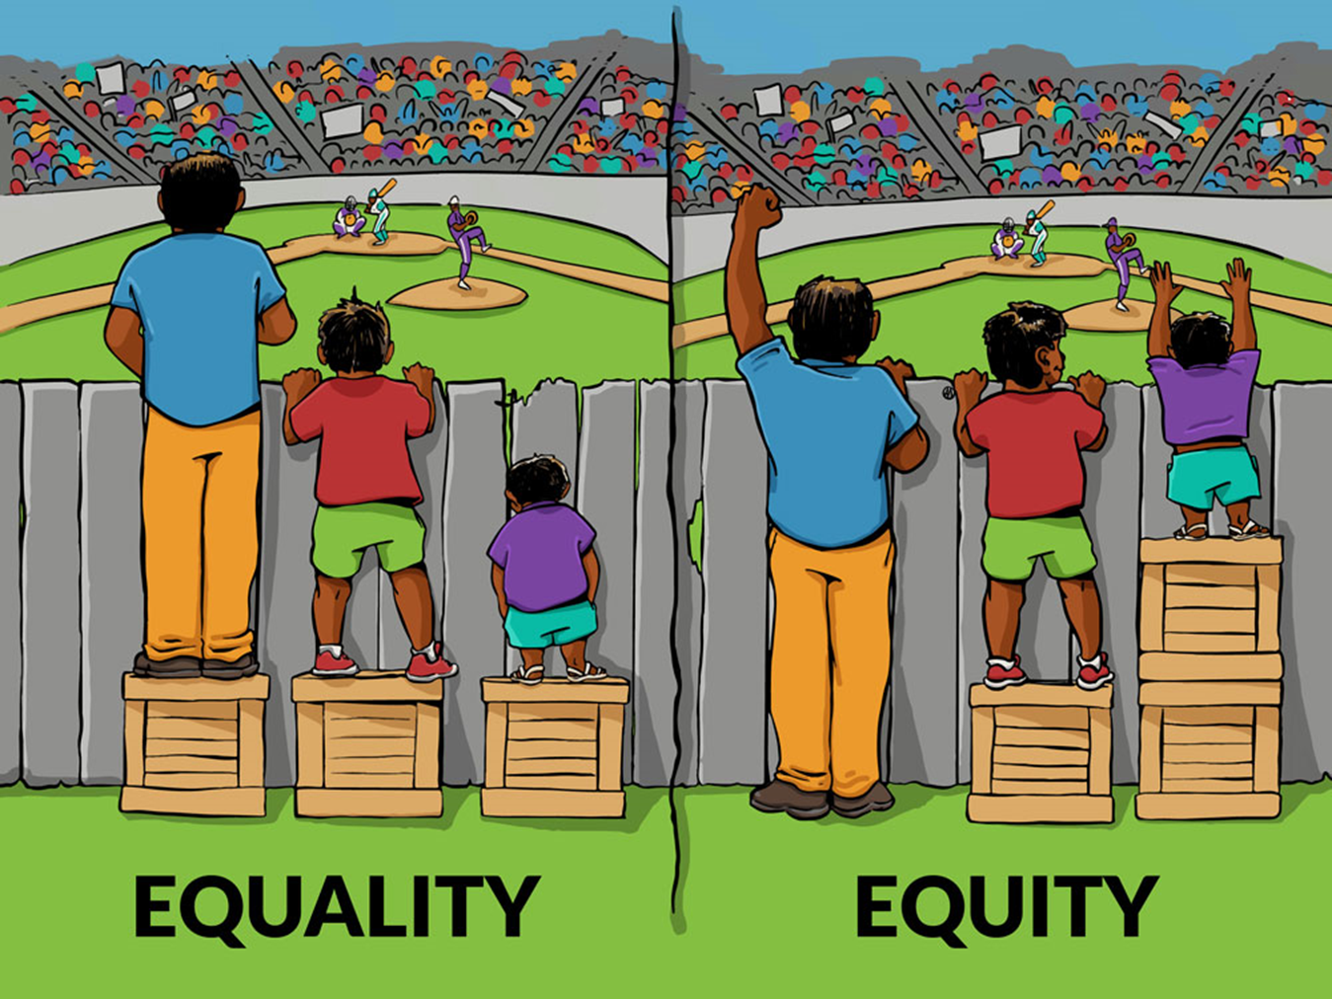
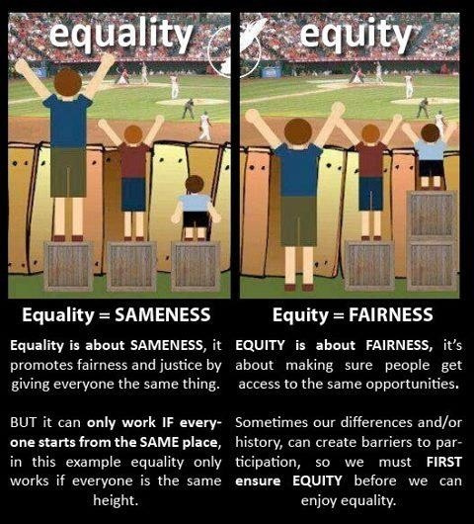
https://www.youtube.com/watch?v=4K5fbQ1-zps

Slide 8
Types of Justice
Organizational Justice:
Made up of Distributive Justice and Procedural Justice.
Individuals react to actions and decisions made by organizations every day. An individual’s perception of these decisions as fair or unfair can have an influence on attitudes and behaviors.
Notes:
This is not only true within the organization but also with decisions that the organization makes (or it representatives---OFFICERS) every day in the community.

Slide 9
Types of Justice
Distributive Justice:
Concerned with outcomes
Distribution of resources
Not only applies within the organization but with the public we serve as well
Notes:
This is not only true within the organization but also with decisions that the organization makes (or it representatives---OFFICERS) every day in the community.
TANGIBLE ----- PAY
INTANGIBLE------ PRAISE
Allocation of police resources
Issuance of citations
Internal…..allocation of manpower

Slide 10
What is Procedural Justice?
Notes:
Most supervisors have a good understanding or at least a basic understanding of the principles of procedural justice both with the workforce as well as with the community
Most employees have figured out how to use the concepts of procedural justice to gain voluntary compliance possibly without even realizing that it is the concepts of procedural justice.

Slide 11
Four Pillars of Procedural Justice
Fairness
Voice
Transparency
Impartiality
Notes:
FAIRNESS AND CONSISTENCY IN RULE APPLICATION
VOICE AND REPRESENTATION IN THE PROCESS
TRANSPARENCY AND OPENNESS IN PROCESS
IMPARTIALITY AND UNBIASED DECISION MAKER NEUTRALITY

Slide 12
Pillar I –Fairness & Consistency of Rule Application
Perception of fairness is driven by two things
Outcomes (distributive justice)
Fairness and Consistency of the process to reach those outcomes (procedural justice)
Which one can we control?
Notes:
PERCEPTION OF FAIRNESS IS NOT JUST DETERMINED BY THE OUTCOME!!!
In other words, the perception of fairness is not just determined by the outcome but heavily influenced by the fairness and consistency of the process to reach those outcomes.
Children (and police officers) often just look at the outcome and say “that’s not fair”
Research argues that in actuality that officers, citizens, etc. are more concerned about the fairness and transparency of the process than the actual result of such. Result oriented is distributive justice
What this is saying is that if Managers or Supervisors are fair and are consistent in the allocation or resources, in decision making, in resolution of disputes, officers and civilian employees will view the agency and fellow employees more favorably and therefore be more supportive of agency goals and policies.
Examples: Discipline process within the police department?
Issuance of a citation? Does the citizen only care about the outcome (citation vs. no citation?) Maybe
or might they take into account how they were treated during the traffic stop? (interactional Justice)
Or do they take in to account much more (procedural justice) ….. Was the process as a whole fair and transparent……as well as being treated fairly and with respect.

Slide 13
Pillar II – Voice and representation in the the process
Voice and representation in the process
Seeking input from those whom the action has a direct impact
What does this achieve
-Demonstrates respect
-Allows for true combining of
ideas
-Allows for an environment
where the individuals feel
comfortable to refute or
support ideas of another
Notes:
Research shows that giving people a sense of “voice” enhances perceptions of fairness.
If this “voice” is allowed within the principles of procedural justice we are going to get greater support and “buy-in”. Again, not only internally but externally with the community as well.
What are we doing within the police department to give ALL a voice and representation in the process?
What are we doing with the community to show the same?

Slide 14
Pillar III – Transparency and Openness of Process
Transparency in the processes by which decisions are made without secrecy or deception
Will gain trust within the organization and the community
Ultimately greater support for the results
Notes:
It is much harder to trust the decisions of your leaders when there are closed door conversations that are perceived as back-door politics
Again, this is not only within the organization both SWORN and PROFESSONAL STAFF but also with the community.
Examples:
Steroid Case
Dillon Eckstrom
Officer Involved Shooting

Slide 15
Pillar IV – Impartiality & Unbiased Decision Making
Standardized
High level of impartiality and unbiased enforcement
No perception of an “in-group” and an “out group”
Based on relevant evidence or data not on mere speculation, rumor, or suspicion

Slide 16
“Policing is one of America’s most noble professions. The actions of any police officer, in an instant, can impact an individual for life, and even a community for generations. Given this realization, every police officer must be centered on what is important.
Service, justice, fundamental fairness—these are the foundational principles in which every police action must be grounded. The nobility of policing demands the noblest of character.”
— Stephen R. Covey

Slide 17
Questions and Discussion

